Slide 1

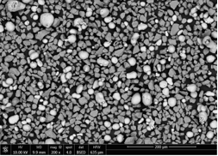
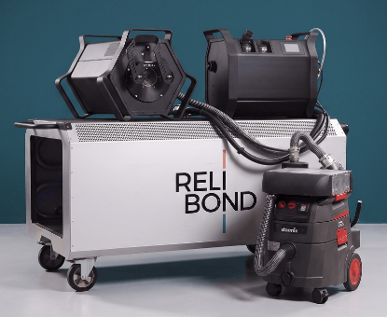
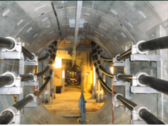
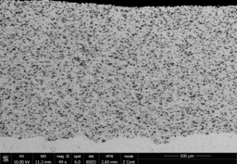
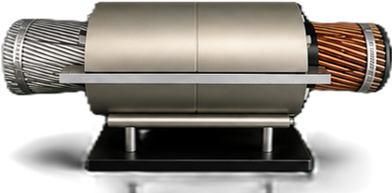
MATERIALS AND SURFACE ENGINEERING
DEPARTMENT OF CIVIL AND MECHANICAL ENGINEERING
PROJECT LEVEL: MSc project, BSc project or special course
From Metal Powder to Electrical Grids
Developing functional cold-spray coatings and quantitative methods
for powder blends
SUPERVISORS
Karen Pantleon
kapa@dtu.dk
Louis Cavichiolo
LC@relibond.com
COLLABORATION
Company ReliBond ApS
PROJECT BACKGROUND
Green energy transition depends on expanding high-capacity electricity grids, including underground and submarine cables connecting offshore renewables to land. Larger conductors enable greater power transmission, but joining them reliably in the field presents a critical installation challenge.
ReliBond’s AlCuCon connector technology provides fast, reproducible connections across conductor materials and designs. It also supports the transition from copper to more abundant aluminum. Functional cold-spray coatings are central to this technology, and their performance starts with the powder.
ReliBond has developed a portable cold-spray platform and established most process parameters.
PROJECT AIM
Developing functional cold-spray coatings and quantitative methods for powder blends:
You will refine Al-, Cu- and Ag-based powder blends with selected filler materials (e.g., Al₂O₃), linking composition and homogeneity to coating quality, storage stability and controllable powder flow.
Shape the experimental strategy with DTU and ReliBond.
PROJECT ACTIVITIES (details to be adapted to the type of project and students’ background)
Design and test blends:
Select fillers and composition ranges using literature and experiments.
Produce coatings and characterise their quality and functional properties.
Develop quantitative methods:
Explore methods of materials characterization )e.g. XRD, XRF, ICP-OES, gasometric analysis, …).
Develop sample preparation, calibration and measurement procedures.
Validate accuracy and mixing endpoints:
Use reference blends and representative sampling to quantify uncertainty, distinguish blend variability and
determine sufficient mixing times.
Connect formulation to performance:
Recommend promising blends and preparation procedures, considering segregation, storage, flowability and
equipment costs for industrial transfer.
Work alongside ReliBond’s team, with access to an office workspace and relevant experimental equipment.
PRACTICAL NOTES
The overall idea can be subdivided into several projects and, concerning content and time frame, be adapted to the students’ education and schedule.
DTU CONSTRUCT / MATERIALS AND SURFACE ENGINEERING

Slide 2
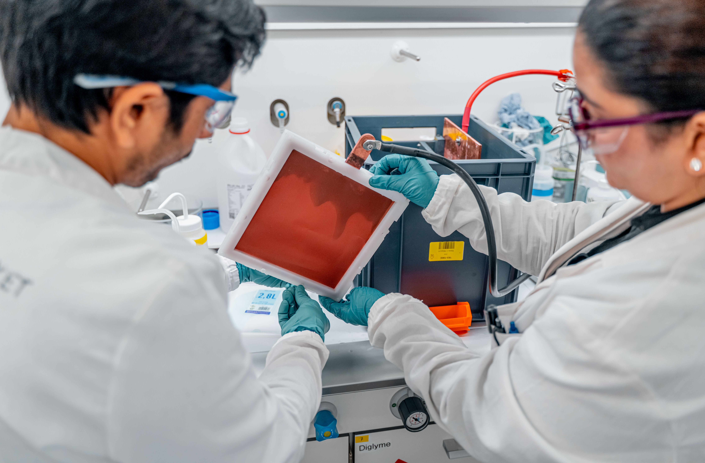
MATERIALS AND SURFACE ENGINEERING
DEPARTMENT OF CIVIL AND MECHANICAL ENGINEERING
PROJECT LEVEL: MSc project or special course
From waste to value: Electrochemical metal recovery
SUPERVISORS
Karen Pantleon
kapa@dtu.dk
Mattia Saccoccio
ms@nitrovolt.com
COLLABORATION
NitroVolt ApS, Søborg
PROJECT BACKGROUND
NitroVolt is an electrochemical company, spun out of DTU, that develops and scales electrochemical processes for industrial applications. As part of its continued growth, it is broadening its technology platform into new application areas, including the recovery of metals from industrial waste and side-streams whose metal content is currently unrecovered and unvalued. By extracting these metals, the process keeps valuable resources in the loop, supporting a more circular economy.
The collaboration combines DTU's expertise in electrochemistry, materials characterization and process modelling with NitroVolt's industrial electrochemistry lab and hands-on scale-up experience, giving the student exposure to both academic rigour and industrial relevance.
PROJECT AIM
The student(s) will contribute to the development of electrochemical metal recovery processes, working on a well-defined sub-problem that fits students’ interests and background. The exact scope is defined together with the student and the supervisors at project start, and can range from fully experimental to fully computational, or a combination of both.
PROJECT ACTIVITIES (details to be adapted to the type of project and students’ background)
The project can be formulated around one or a combination of the following topics:
Feedstock characterization – sampling and characterizing industrial side-streams (composition, metal content, impurities) to assess their suitability for electrochemical and/or hydrometallurgical metal recovery.
Process design and optimization – designing, running and optimizing electrochemical recovery experiments (e.g. electrodeposition, electrooxidation/electroreduction) at bench or beaker scale, including electrode, electrolyte and operating-window selection.
Physics-informed digital twin modelling – developing or validating process models (e.g. 1D electrochemical bath models) against experimental data, to support process understanding, design and scale-up decisions.
Combined experimental/modelling work – linking laboratory data to model development or validation, building methodologies that can be reused across chemistries and waste streams.
The project can be based mostly at DTU, mostly at NitroVolt, or split between the two, depending on the chosen direction and the facilities required.
PRACTICAL NOTES
We are looking for curious and ambitious students who want to develop sustainable solutions and are motivated to work at the interface between experimental science and industrial process development. A background or interest in chemistry, materials science, chemical/mechanical engineering, electrochemistry or process modelling is welcomed.
DTU CONSTRUCT / MATERIALS AND SURFACE ENGINEERING

Slide 3
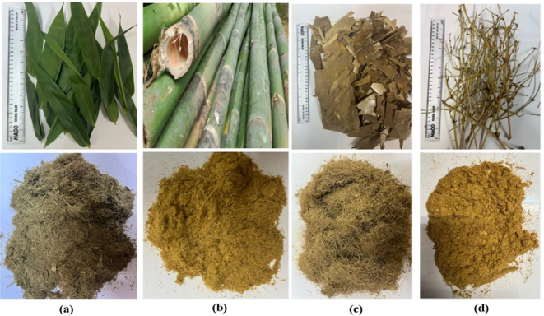
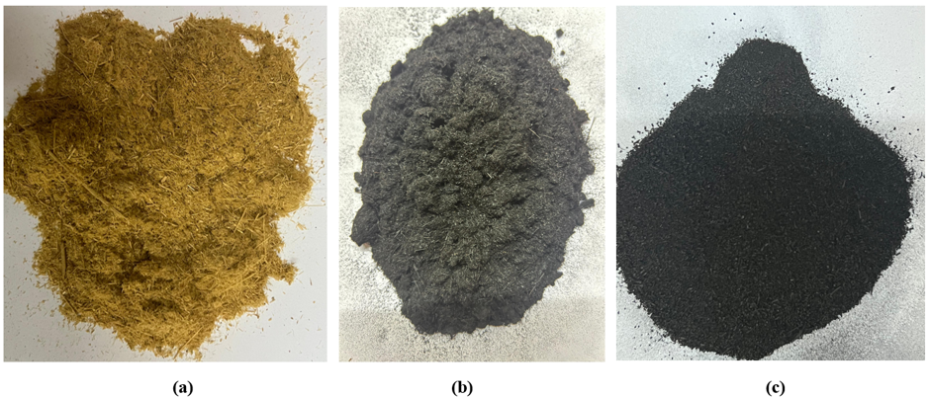
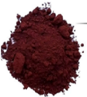
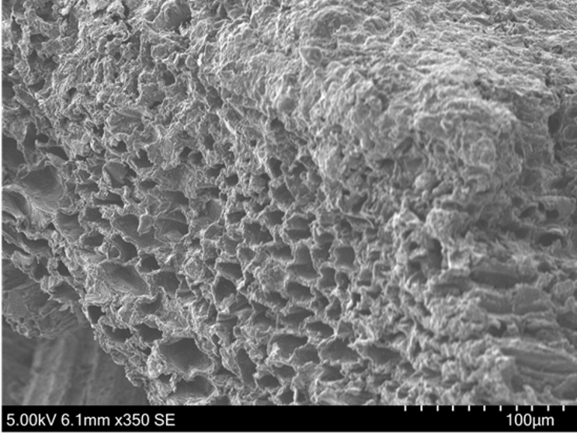
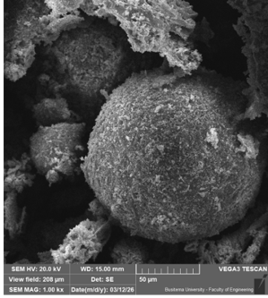
MATERIALS AND SURFACE ENGINEERING
DEPARTMENT OF CIVIL AND MECHANICAL ENGINEERING
PROJECT LEVEL: MSc project, BSc project, BEng or special course
Sustainable electrodes for hydrogen evolution:
from biomass and steel industry waste to hydrogen production
SUPERVISOR
processing
pickling dust
(iron oxide)
Karen Pantleon
kapa@dtu.dk
processing of bamboo
to synthesize porous
carbonaceous material
+
COLLABORATION
Makerere University, Uganda
PROJECT BACKGROUND
The development of sustainable electrodes, e.g. for hydrogen production, relies on the use of abundant, naturally occurring raw materials or waste currently disposed of by landfilling, which (until now) are unused resources.
Bamboo, a climate resilient and rapidly growing, renewable, natural material, is composed of cellulose, hemicellulose and lignin, which can be decomposed by thermal treatments to form porous carbonaceous materials.
Pickling dust, a residue from steel processing industry mainly consisting of iron oxides, can be processed towards the transformation from hematite (Fe₂O₃) to magnetite (Fe₃O₄) and functionalization to enhance the catalytic activity.
Bamboo and pickling dust, collected in Uganda, are low-cost resources for producing nano-composite electrodes.
PROJECT AIM (or smaller steps towards this final goal)
Prototyping sustainable electrodes based on bamboo-derived carbon and pickling waste by testing various production methods, with focus on later upscaling to industrial production in Uganda.
PROJECT ACTIVITIES
Investigating and optimizing bamboo-derived carbon:
Phase identification and chemical analysis of raw and thermally treated bamboo. In particular, the presence of
naturally occurring unorganic phases in raw bamboo and their influence on (electrical, electrochemical) properties and morphology of the processed bamboo-derived carbon are of interest.
Measurement of relevant properties:
For both parts of the final composite electrode, electrical conductivity and active surface area are highly relevant.
Optimizing processing routes:
Revealing the relationship between processing parameters (e.g. temperature, time, atmosphere) for the thermal
treatment of both bamboo (carbonization, activation, doping) and pickling dust (phase transformation,
functionalizing). Testing of combined treatments.
Testing and comparing different methods of combining carbon and iron oxide to produce composites with propeties that are relevant for electrodes.
These are suggestions acting as examples for meaningful project(s) or smaller tasks, which will be finally formulated based on the students’ background and the time frame of the project. Materials characterization will be essential.
PRACTICAL NOTES
The project is carried out at DTU, and include online collaboration with project partners in Uganda.
DTU CONSTRUCT / MATERIALS AND SURFACE ENGINEERING

Slide 4
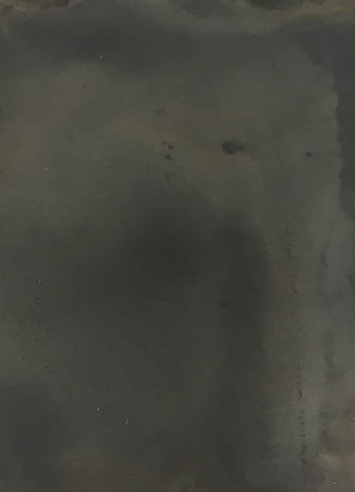
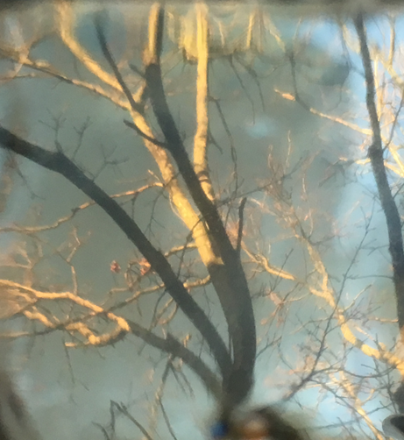
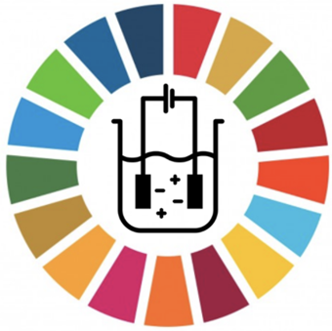
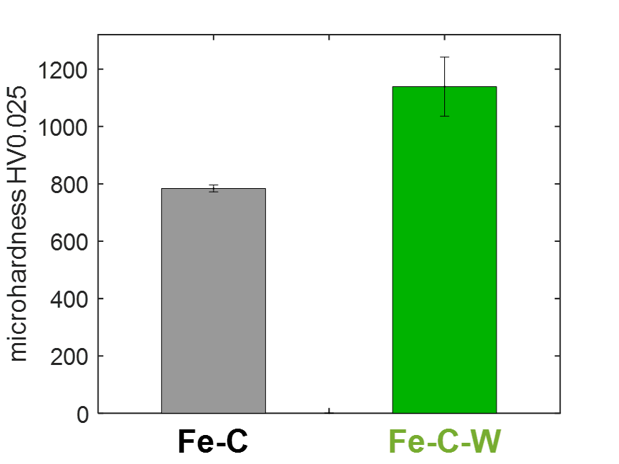
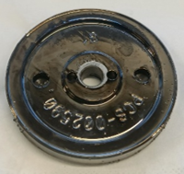
MATERIALS AND SURFACE ENGINEERING
DEPARTMENT OF CIVIL AND MECHANICAL ENGINEERING
PROJECT LEVEL: MSc project, BSc project or special course
Surface engineering with Fe-C-based alloy coatings by sustainable electroplating
SUPERVISOR
as-deposited:
Karen Pantleon
kapa@dtu.dk
PROJECT BACKGROUND
For surface protection from mechanical and/or chemical damage, electroplating has a long tradition in industry. Present challenges concern the replacement of traditional but harmful electrolytes to sustainable plating using electrolytes, which are not hazardous to neither human health nor environment – without compromising coating properties.
Novel electroplated iron-based coatings (recently developed at DTU Construct) utilize the intentional co-deposition of carbon from citric acid containing electrolytes, which results in high carbon contents of about 0.8 wt% C. The as-deposited Fe-C coatings provide excellent very high microhardness, which further increases by dedicated post-deposition annealing.
PROJECT AIM
Depending on the students’ background and interest, different projects are possible aiming at
EITHER - development of electrolytes incl. testing of plating abilities
OR - materials characterization of as-deposited and post-deposition treated coatings from sustainable plating
PROJECT ACTIVITIES (examples)
Suggestions for sustainable electroplating of iron-carbon-based coatings:
Work in the galvano-lab at DTU:
Testing and further developing non-hazardous and environmentally friendly electrolytes.
Post-deposition annealing of as-deposited samples:
Systematic thermal treatments at either isothermal or isochronal conditions, incl. materials characterization.
Complementary materials characterization of electroplated samples:
Perform materials characterization based on microscopy, spectroscopy and diffraction analysis and relate the
coatings’ internal structure to the applied parameters of electroplating.
Characterisation of relevant properties:
Depending on the type of electroplated materials and the applied substrates, mechanical and/or electrochemical
and/or electrical properties would be relevant.
Sustainable plating of coatings other than Fe-C-based alloys … - let´s discuss.
PRACTICAL NOTES
Several projects are possible with content and time frame, depending on the students’ education.
DTU CONSTRUCT / MATERIALS AND SURFACE ENGINEERING

Slide 5
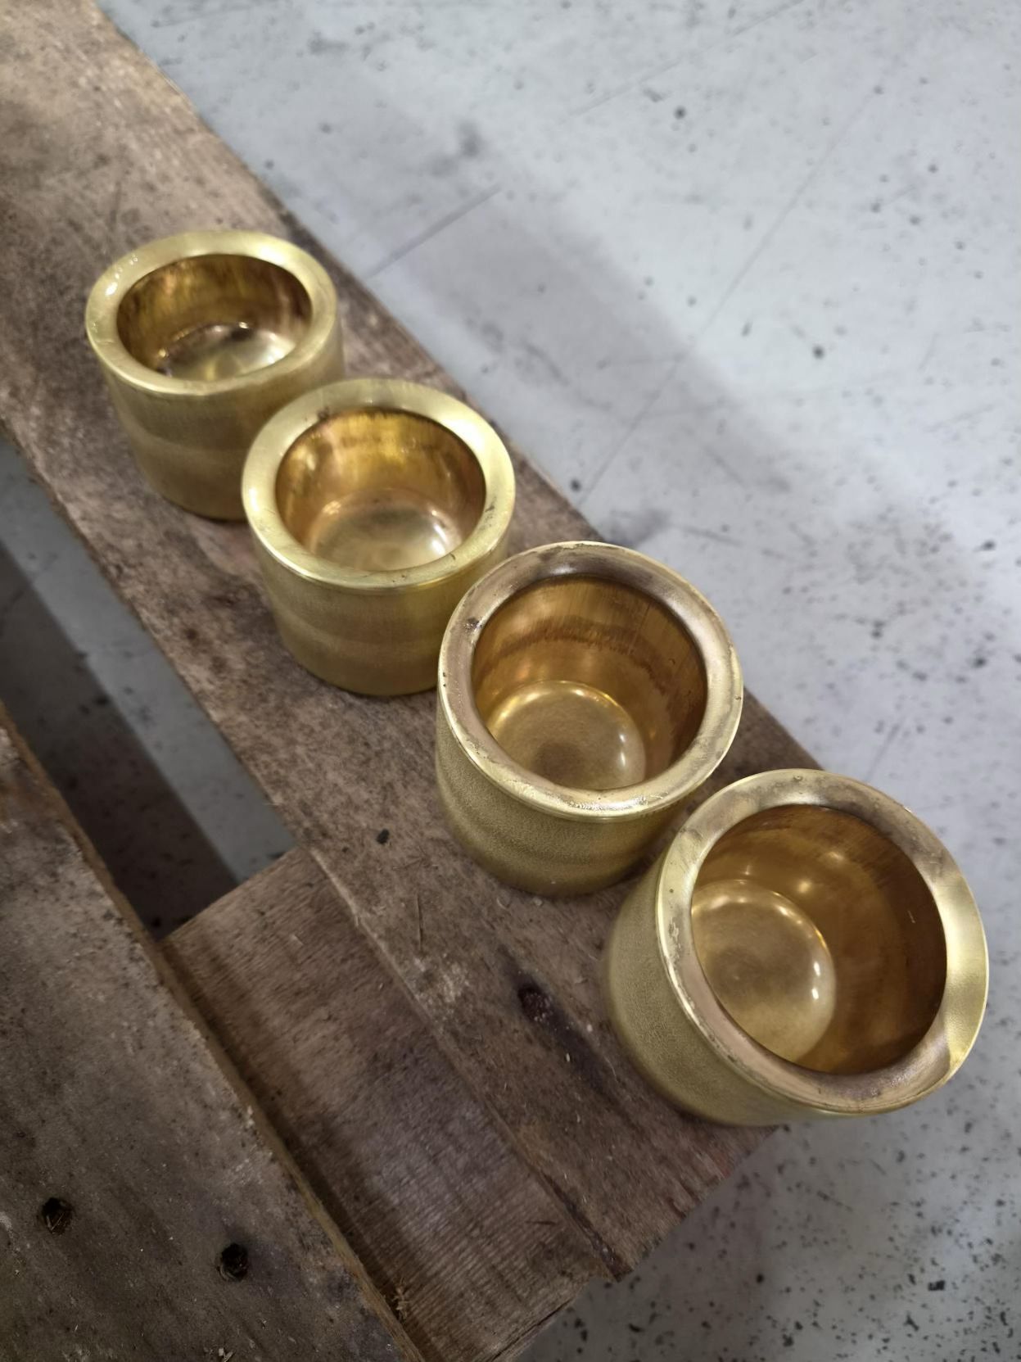
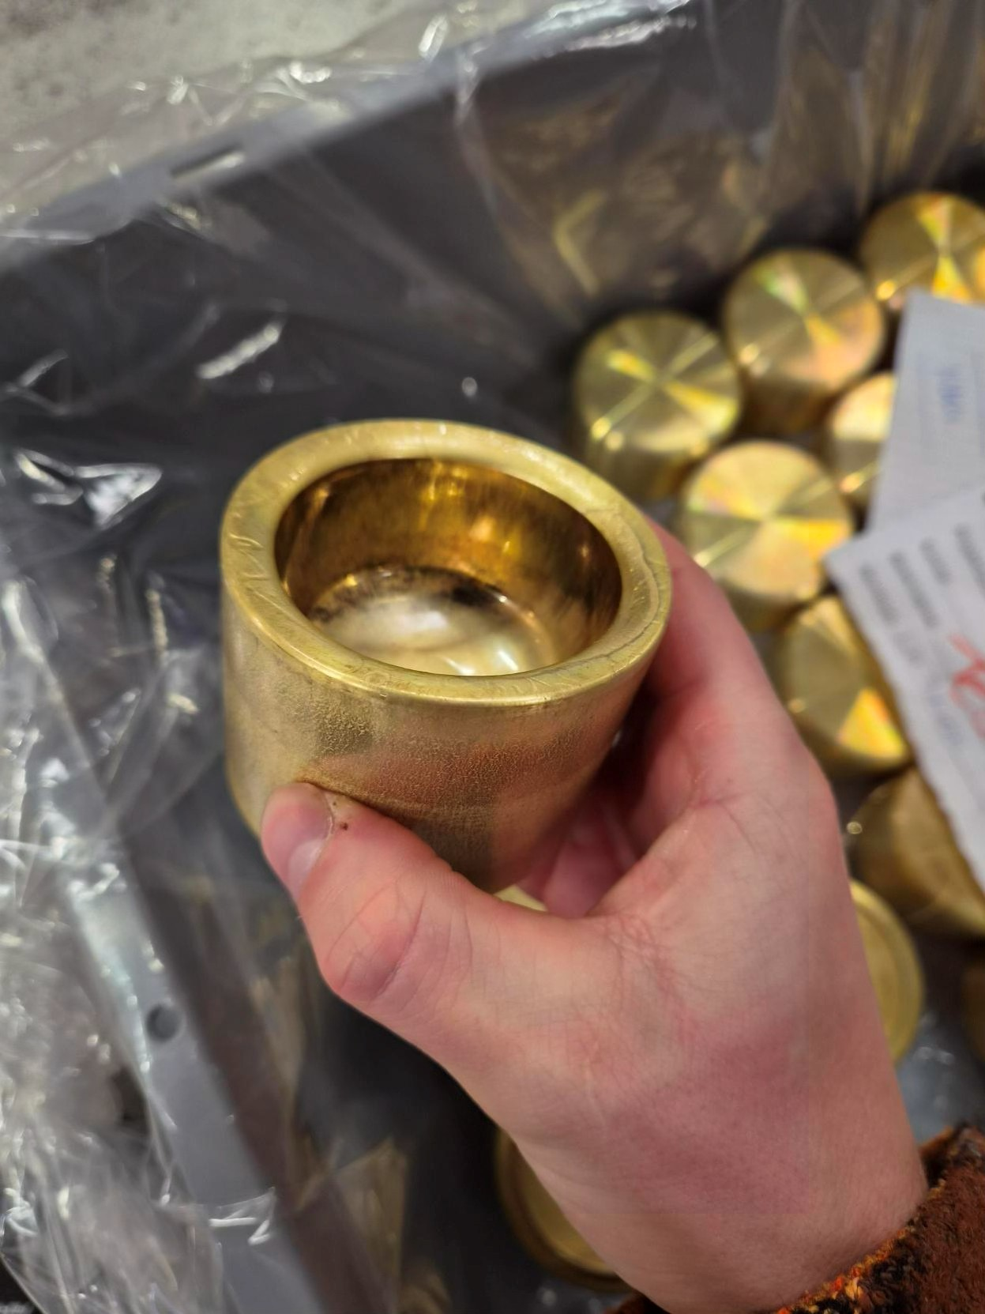
MATERIALS AND SURFACE ENGINEERING
DEPARTMENT OF CIVIL AND MECHANICAL ENGINEERING
PROJECT LEVEL: MSc project, BSc project, BEng project or special course
Relation between microstructure and hardness for
cold-forging of brass components
SUPERVISORS
Karen Pantleon
kapa@dtu.dk
Chris Valentin Nielsen
cvni@dtu.dk
Casper Hasle Clausen
ccl@Steelproducts.dk
COLLABORATION
Steel Products, Horsens
PROJECT BACKGROUND
More than 100 years ago, the Danish company Steel Products was established and over the years has specialized in manufacturing products made of different alloys, not only steels. One of its present developments addresses brass components, which rely on the interplay between deformation and annealing. This meets new challenges of understanding and optimizing the relationship between the materials’ microstructure – properties – processing – performance of the final brass product.
For cold-forging brass components, their initial microstructure and related properties are crucial.
In general, the expectation is, the softer the material, the easier to cold-forge. However, annealing of the raw material makes some brass alloys harder and this results in a more difficult cold-forging process. Understanding this phenomenon from a material’s perspective and suggesting the most suitable raw material characteristics is of interest.
PROJECT AIM
Relate microstructure and mechanical properties of Cu-Zn alloys (brass) to their ability of cold-forging industrial products.
Suggest the optimal characteristics of the raw material for optimized cold-forging.
PROJECT ACTIVITIES
With focus on real industrial products, the following topics are suggested:
Investigation of as-delivered brass in relation to cold-forging:
Delivery conditions of several batches of brass can vary a lot in microstructure and associated hardness, despite
the same chemical composition of the Cu-Zn alloy.
Systematic analysis of as-delivered alloys using microscopy (LOM and SEM) and hardness testing should be
carried out and be linked to the cold-forging ability of the alloys. Tensile testing might be an additional option
(for longer projects).
Site-specific materials characterization of industrial products as a function of processing steps:
During cold-forging, the applied brass alloy(s) are subjected to different degrees of deformation, resulting in
varying microstructure and properties within a product. Additional changes are expected due to annealing
in-between various steps of deformation in the progress of manufacturing.
Site-specific materials characterization should be linked to the applied processing.
PRACTICAL NOTES
The work is carried out at DTU, in close collaboration with the company.
DTU CONSTRUCT / MATERIALS AND SURFACE ENGINEERING

